Slide 1
User Hack Clustering
Data Mining Final project
By Asad Tanveer and Tanish Sanghvi

Slide 2
ABOUT
User Hack aims to ‘hack’ user data and separate them into different groups or segments based on shared characteristics
Companies can profit from knowing their customer segments as they can then create contextualized advertisements or enhance their digital engagements based on the ‘taste’ of their users
In the following project we have created a blueprint of this process by utilizing YouTube data and it’s API which provides various metrics about a user such as their playlists, videos, commenters and so on

Slide 3
SUMMARIZED WORKFLOW
Get a list of videos (video_ids) belonging to a particular industry (music, travel, finance etc)
Pull the list of commenters on these videos
Pull the list of playlist ID’s belonging to these users
Pull the list of videos belonging to these playlists
Pull the ‘tags’ belonging to each video
Use NLP techniques to clean these tags followed by K-means in order to cluster the users based on their preferences (‘tags’)

Slide 4
PROJECT DETAILS - PRE-PROCESSING
Find videos (YouTube video ID’s) relevant to a specific segment/industry/domain.
We found such a data set on Kaggle which had 2607 video ID’s from various categories such as science, food, history etc
For our use case, we decided to choose ‘Travel’ as the dataset had the most videos (559) from this category
Use the YouTube API to pull the commenters (their ID’s) on these videos
Due to API rate limit restrictions we restricted to pulling maximum 100 commenters from each video

Slide 5
PROJECT DETAILS - PRE-PROCESSING
Once we got a core set of unique users/commenters (~3000), we decided to pull data about their playlists
Again due to rate limit constraints we had to restrict ourselves to maximum 20 playlists per user
Similarly, once we had access to their playlists, we decided to pull data around the videos (~2M) in these playlists (again restricted to maximum 50 videos per playlist)
The reason behind accessing all this data is that YouTube provides ‘tags’ related to all videos on its platform. So one could expect a ‘Yoga tutorial’ video on YouTube to have tags such as - ‘health’, ‘exercise’, ‘mental well-being’
Such ‘tags’ could help one get an idea of the type of videos a particular user watches

Slide 6
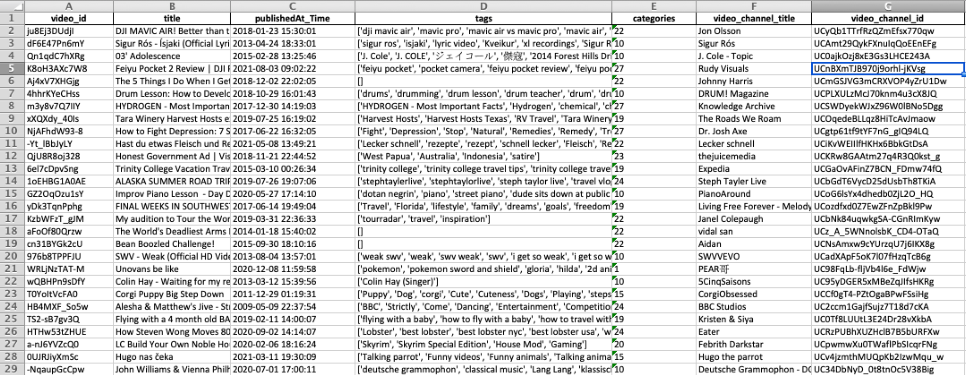
SAMPLE DATA SET

Slide 7
POST-PROCESSING - DATA MINING PROCESSES APPLIED
NLP to clean our ‘tags’ (removing stop-words, removing non-english words etc)
TF-IDF to weigh words based on their occurrence in a text and the entire corpus
PCA in order to get the most relevant features/tags from these videos (~1500 features explained 90% of the variability in the data)
Elbow Curve and J-Squared Error in order to determine the optimal number of clusters
K-means Clustering in order to cluster users based on their tags

Slide 8
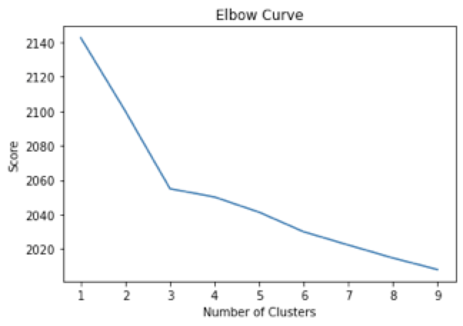
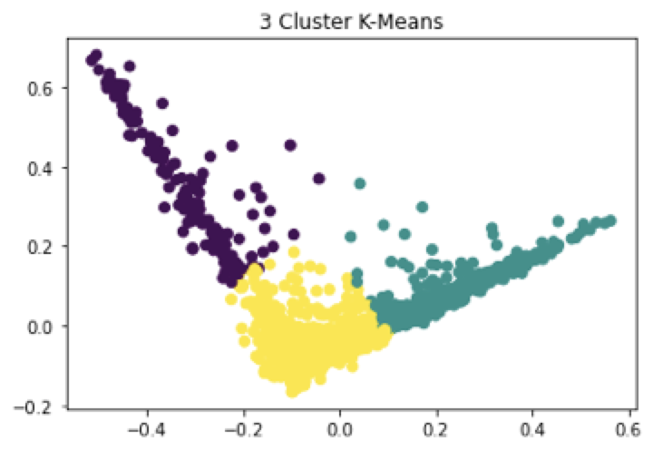
RESULTS
Elbow Curve
K-Means Clustering

Slide 9
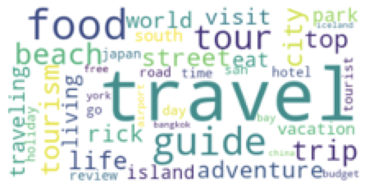
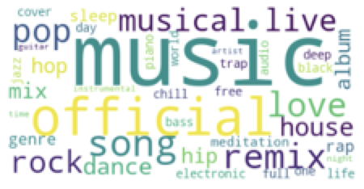
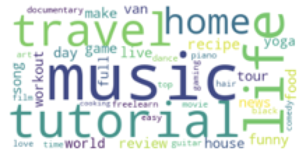
RESULTS
Word Cloud
Travelling
Music
Animation

Slide 10
FURTHER SCOPE
Use Silhouette Score to validate optimal number of clusters
Try applying Hierarchical Clustering and see the difference in results
Use neural networks to see if it can help optimize the results

Slide 11
REFERENCES
https://www.kaggle.com/harshitmakkar/youtube-videos-idtitledescription-and-category
https://www.natasshaselvaraj.com/customer-segmentation-with-python/
https://www.geeksforgeeks.org/elbow-method-for-optimal-value-of-k-in-kmeans/
https://www.kaggle.com/albeffe/text-clustering-tfidf-pca-beginner-tutorial
https://developers.google.com/youtube/v3/docs

Slide 12
THANK YOU

